Slide 1
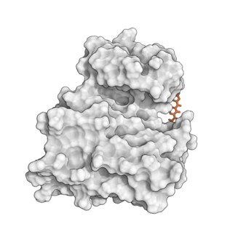
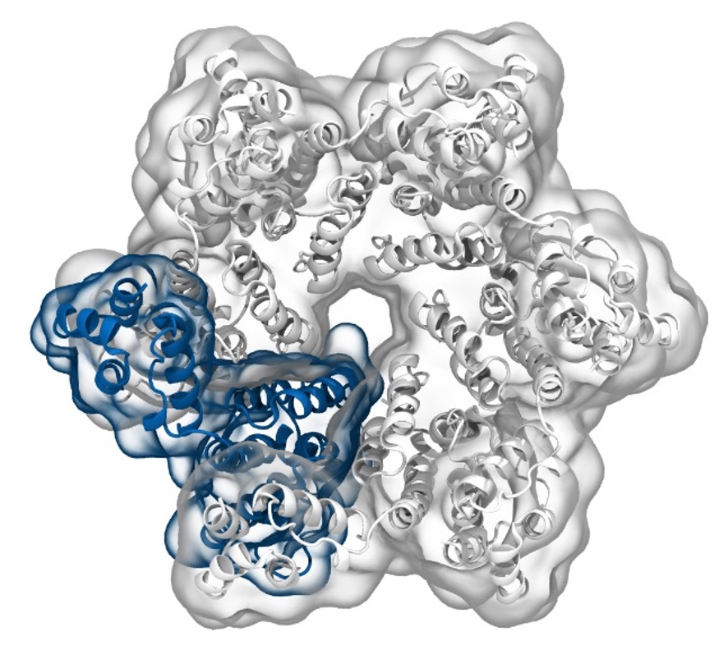
Simulation of Biomolecules
Basic Simulation
Analysis
2024 CCP5 Summer School
Dr Matteo Degiacomi
Durham University
matteo.t.degiacomi@durham.ac.uk
Dr Antonia Mey
University of Edinburgh
antonia.mey@ed.ac.uk

Slide 2
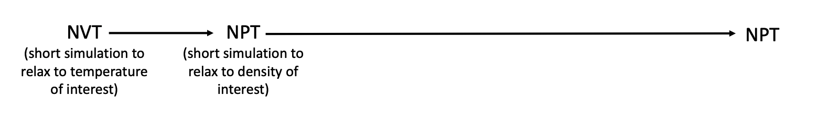
Volume and pressure equilibration
Steps until production:
Production ensemble
Minimisation
Living J.Comp.Mol.Sci. 2019,1,5957

Slide 3
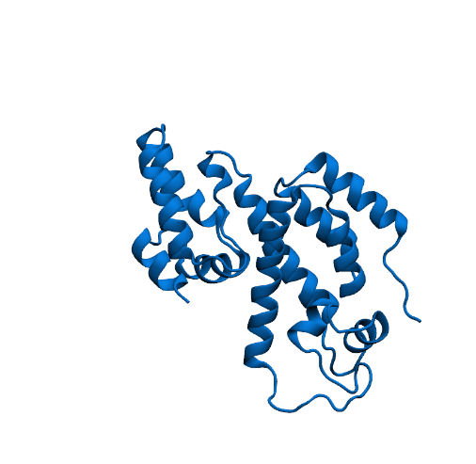
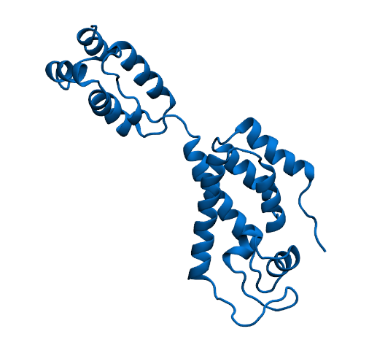
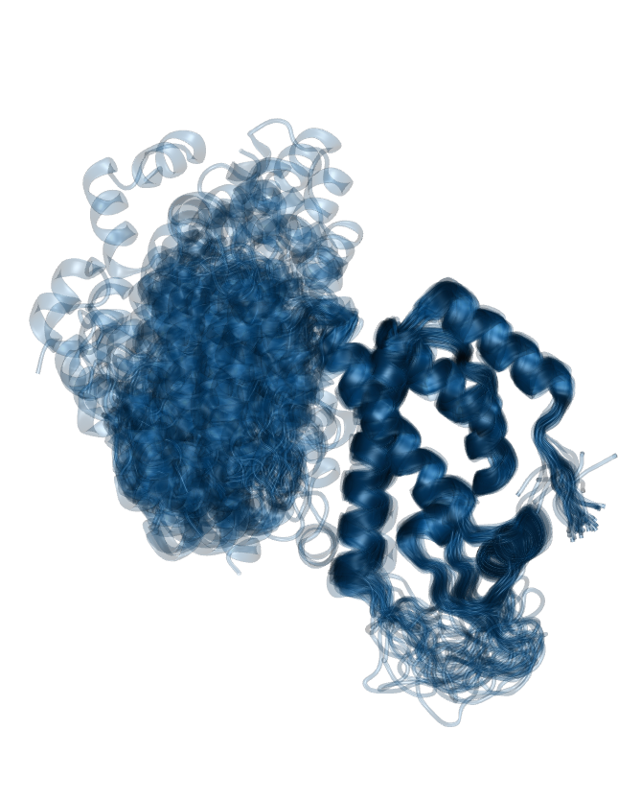

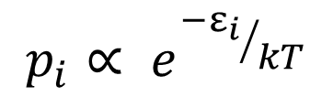
Sampling the conformational space
Space of all arrangements of atoms
$$p_{i}∝ e^{{−ε_{i}}/{kT}}$$
Probability of sampling a conformation is inversely proportional to its energy:

Slide 4
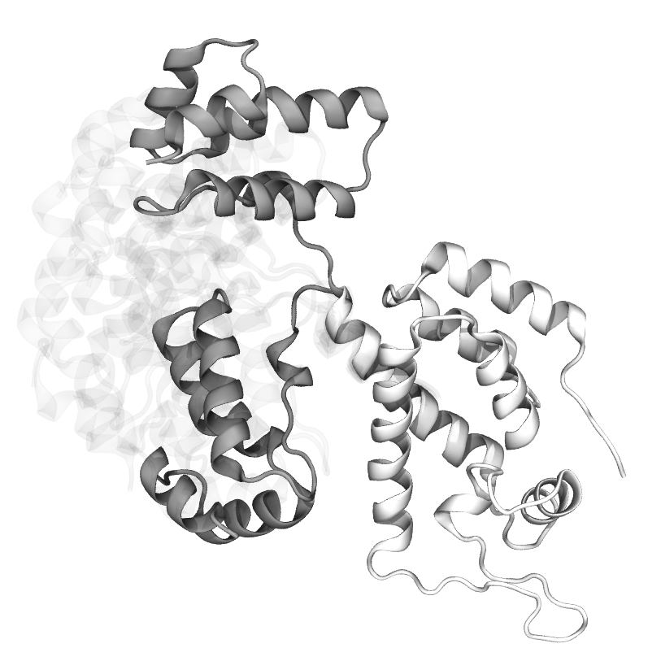
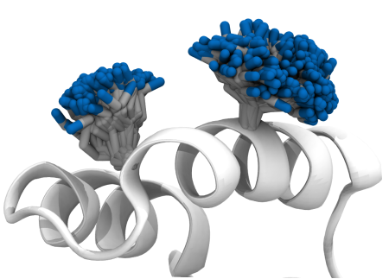
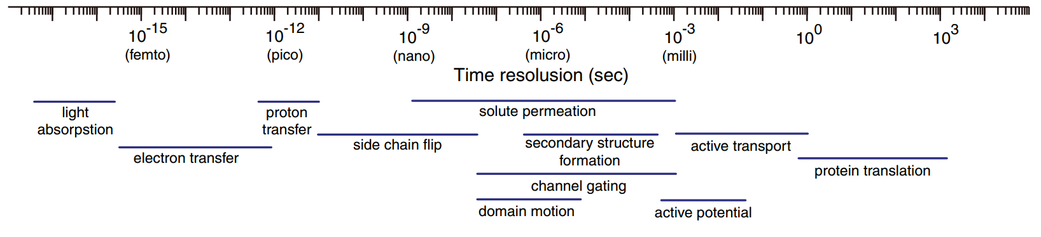
Timescales in biology
Different regions, different timescales:
Side chains faster than backbone
Loops faster than helices and sheets
backbone faster than side chains
Protein surface faster than core
MD

Slide 5
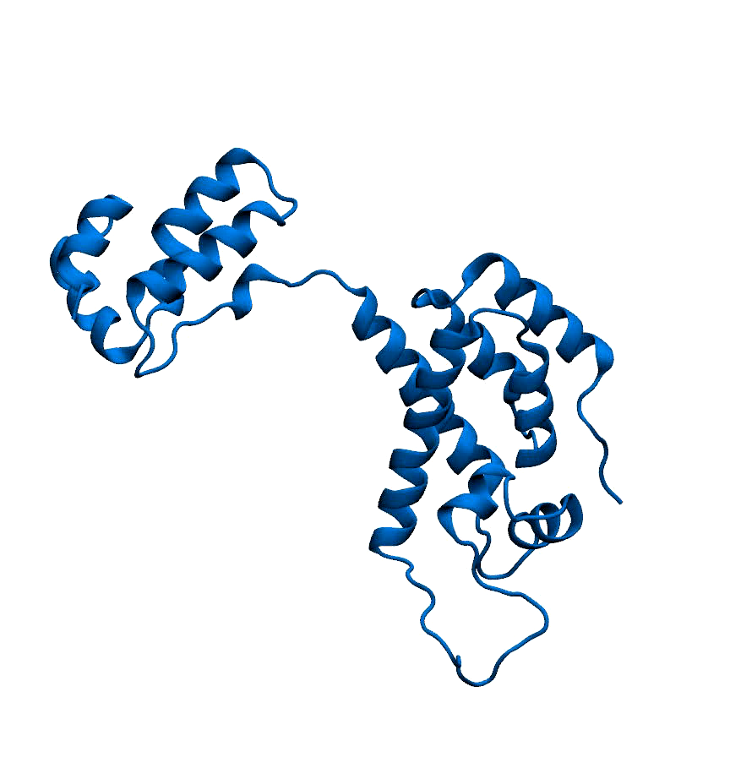
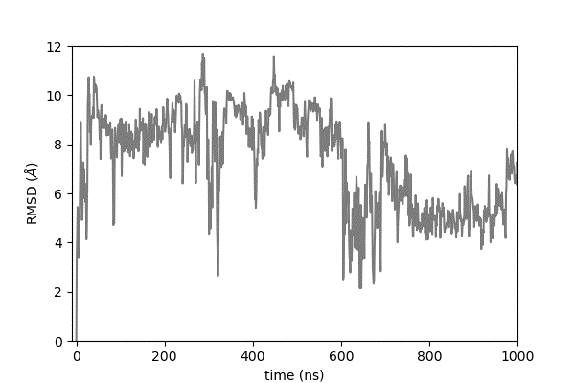
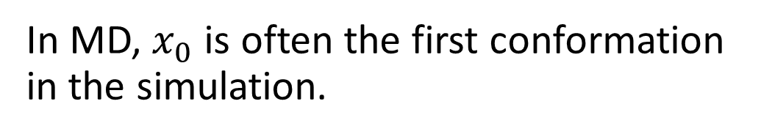
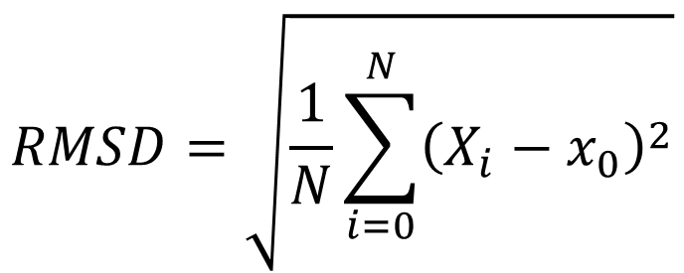

Root Mean Square Deviation (RMSD)
Given a system with N atoms, and a reference arrangement $x_{0}:$
$$RMSD=\sqrt{\frac{1}{N}\sum_{i=0}^{N}{{\left(X_{i}−x_{0}\right)}^{2}}}$$
In MD, $x_{0}$ is often the first conformation in the simulation.
HIV-1 capsomer simulation from: Degiacomi & Dal Peraro, Structure, 2013

Slide 6
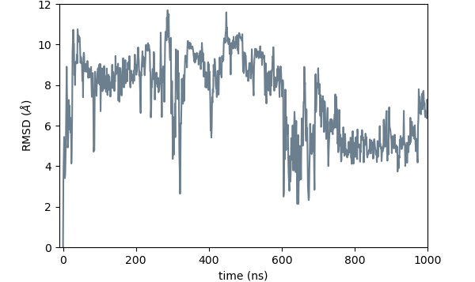
Convergence?
Refrain from using RMSD as a single indicator of simulation convergence.
HIV-1 capsomer simulation from: Degiacomi & Dal Peraro, Structure, 2013

Slide 7
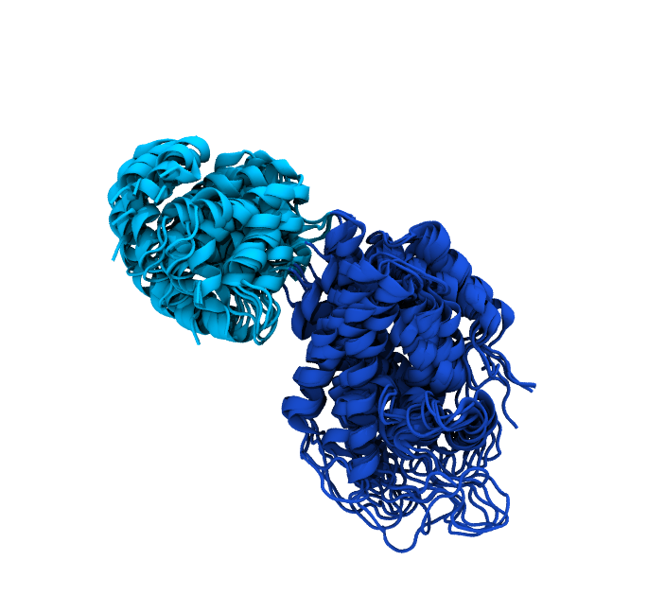
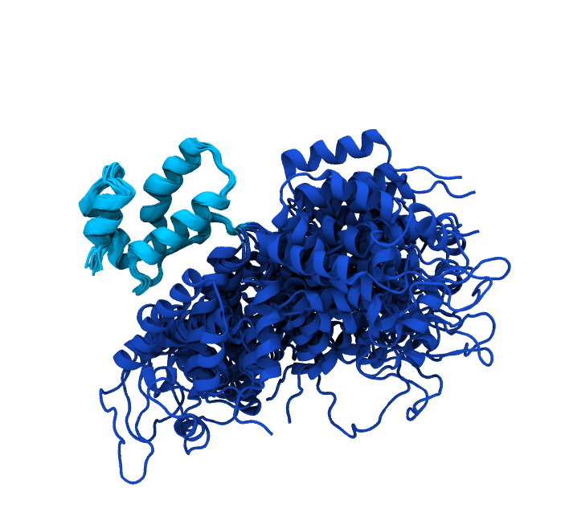
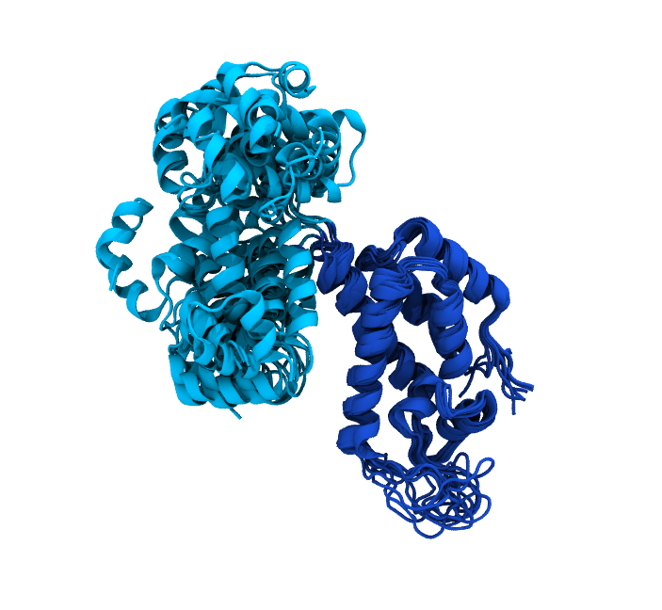
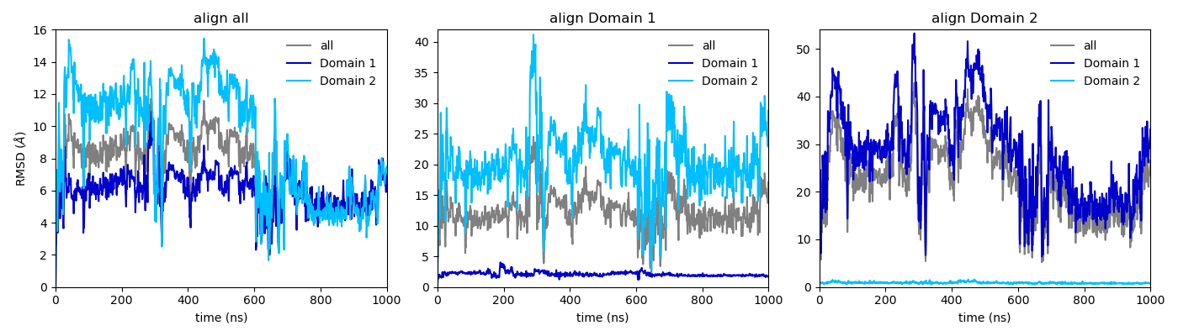
RMSD is alignment- and selection-dependent
Domain 2
Domain 1
align all
align Domain 1
align Domain 2

Slide 8
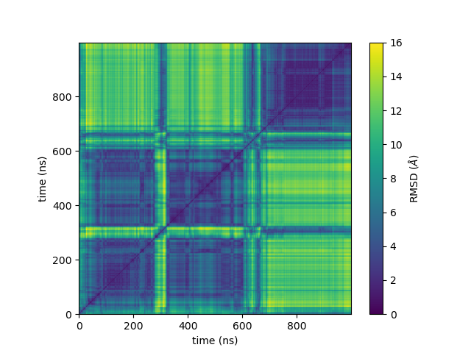
Pairwise RMSD
Two structures with same RMSD from a reference are not forcefully similar to each other.
Pairwise RMSD helps seeing if protein re-visits conformations throughout the simulation.

Slide 9
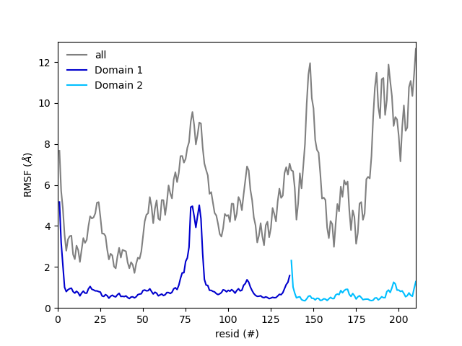
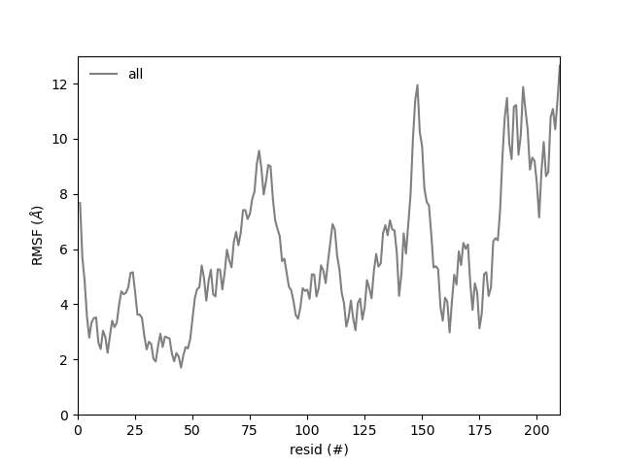
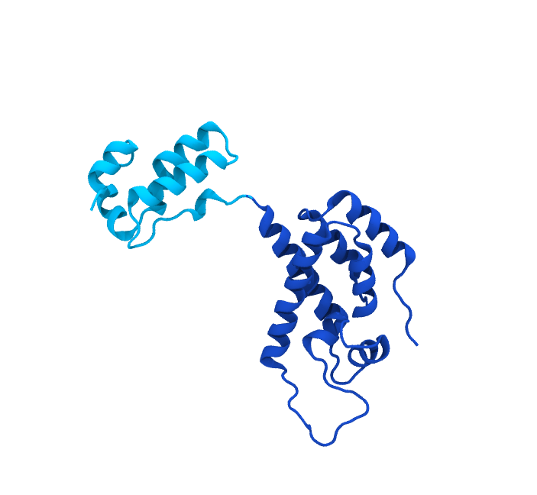
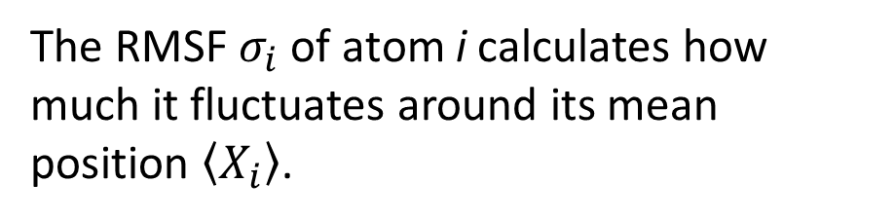
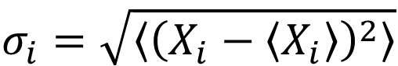
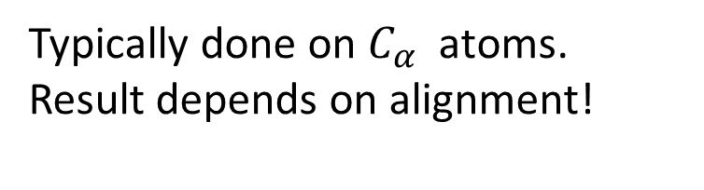
Root Mean Square Fluctuation (RMSF)
The RMSF $σ_{i}$of atom i calculates how much it fluctuates around its mean position $\left\langle X_{i}\right\rangle$.
$$σ_{i}=\sqrt{\left\langle {\left(X_{i}−\left\langle X_{i}\right\rangle \right)}^{2}\right\rangle }$$
i
Typically done on $C_{α}$ atoms. Result depends on alignment!

Slide 10
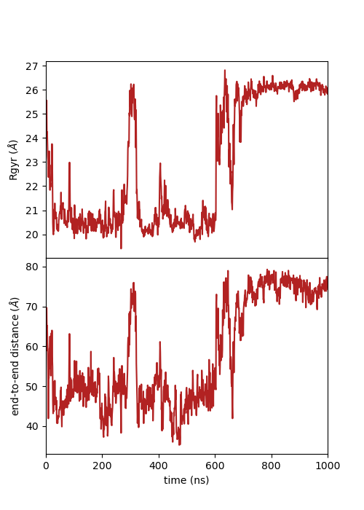
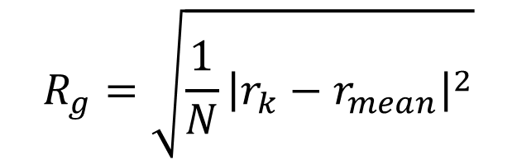
end-to-end distance and Radius of Gyration (Rg)
$$d(p,q)=\left\|p−q\right\|$$
$$R_{g}=\sqrt{\frac{1}{N}{\left|r_{k}−r_{mean}\right|}^{2}}$$
q = C-ter
p = N-ter
Internal properties do not depend on alignment

Slide 11
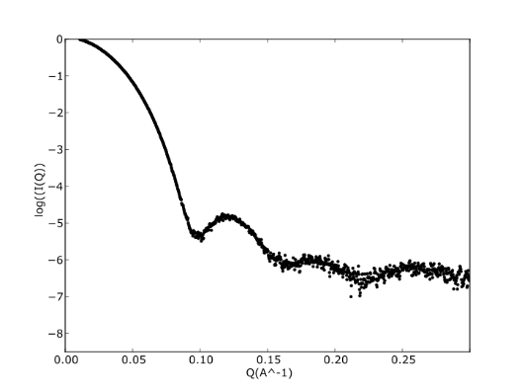
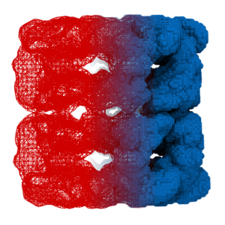
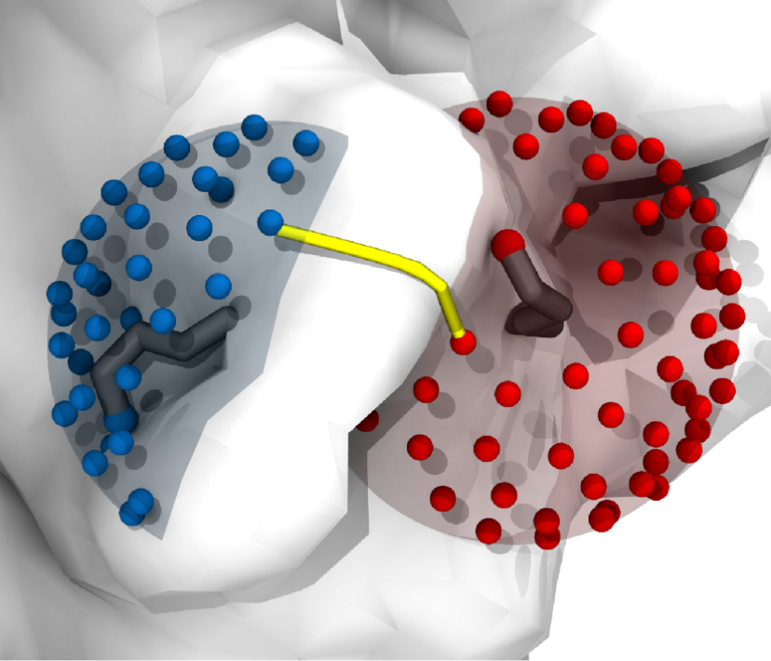
Some quantities are not directly measurable
Submit MD conformers to external software simulating experimental data, e.g.:
Chemical cross-linking
SAXS
Collision cross-section
DynamXL, Xwalk, …
CRYSOL, FoXS, …
IMPACT, MobCal,
CollisionCode, …

Slide 12
Warning: time averaging may hide processes
Thought experiment: typically hydrogen bond is considered established if donor-acceptor distance <2.5 Å, and donor-acceptor-hydrogen angle <20°.
bond
formed
50%
bond not
formed
50%
time
time
Reporting % time a bond is established in simulation can be misleading!

Slide 13







Large ecosystem of software and packages for data analysis
And many more…
13

Slide 14

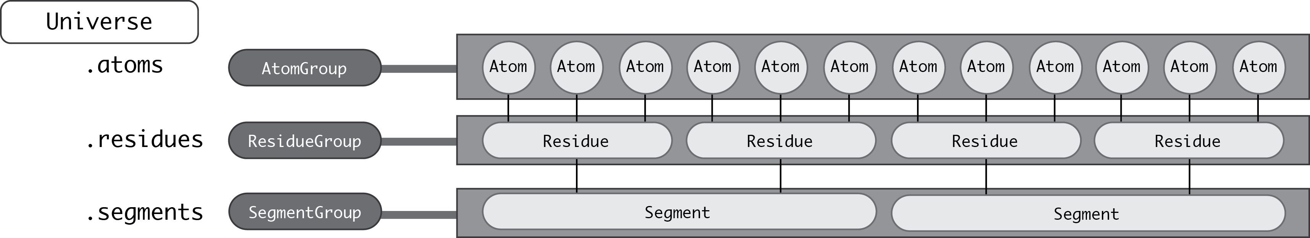
MDAnalysis
The Universe contains everything about a MD system
Static information: atoms and their connectivities
Dynamic information: The trajectory
Data accessible via a hierarchy of containers

Slide 15
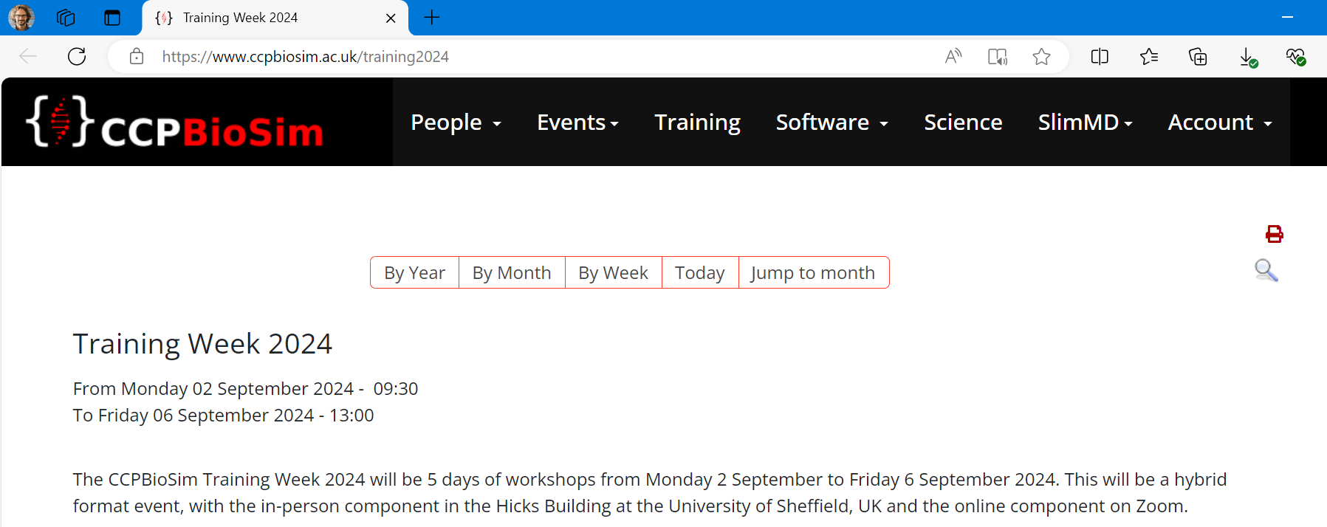
Thursday 03 September 2024, 9:30am – 5pm : Intermediate and Advanced MDAnalysis
This workshop will build on basic MDAnalysis skills to learn about building more complex analysis scripts.
Please feel free to bring your own systems and problems to get help from the experts.

